Slide 1
EMC-GUI
External Motion Control Client with User Interface

Slide 2
Purpose
To create a client application with a user-friendly interface that sends commands to and receives data from an External Motion Control (EMC) Server using UDP message passing.
The client app will be used to collect flight simulation data from the Motion Control (MC) and EMC server.
Will replace the current inconvenient method of using SSH to manually access the server.

Slide 3
Goals
This project will be successful if:
The client can send and receive UDP packets to/from EMC.
The client can parse received data and correctly display data values.
The user can press a button to send a stop command to the EMC.
The user can select options relating to EMC setup and send selections to the server.
The client properly receives a “Run” command from the MC via the EMC.
All options are presented to the user at the correct times.

Slide 4
The Team
Kate McManus – mcmanukn@mail.uc.edu
Project Advisor - Dr. John Christopher Gallagher – gallagj9@ucmail.uc.edu

Slide 5
Abstract
Naval Medical Research Unit – Dayton frequently runs flight simulations and collects data using a motion system and external motion control server to send commands and receive data. The purpose of the server is to allow the researcher to control the motion system from the control room. However, the current method of interacting with the server using remote shell SSH is not cohesive and inconvenient for the researcher. The EMC-GUI client provides a user interface that sends commands to and receives data from the server, allowing researchers to easily connect to the server.

Slide 6
User Stories
As a researcher, I want to collect data from both the Motion Control and the External Motion Control (EMC) server so that I can see all data in real time in the same place.
As a researcher, I want to select run setup options for running the EMC server so I can run a test with the correct setup parameters.
As a researcher, I want to be able to start and stop Motion Control using a button, so I can control a test from the same software that I collect data from.

Slide 7
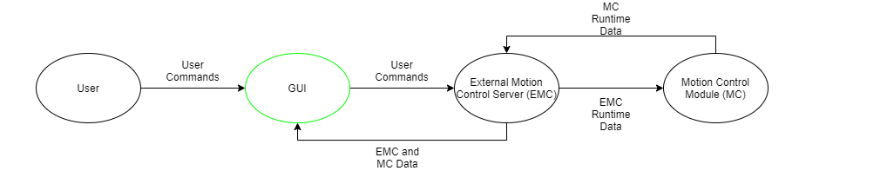
Design Diagram - Overview

Slide 8
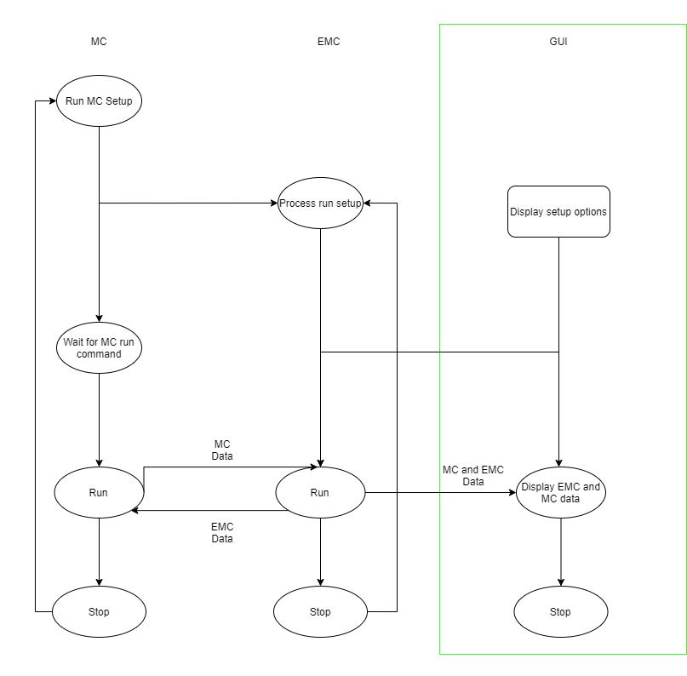
Design Diagram – Basic Functions

Slide 9
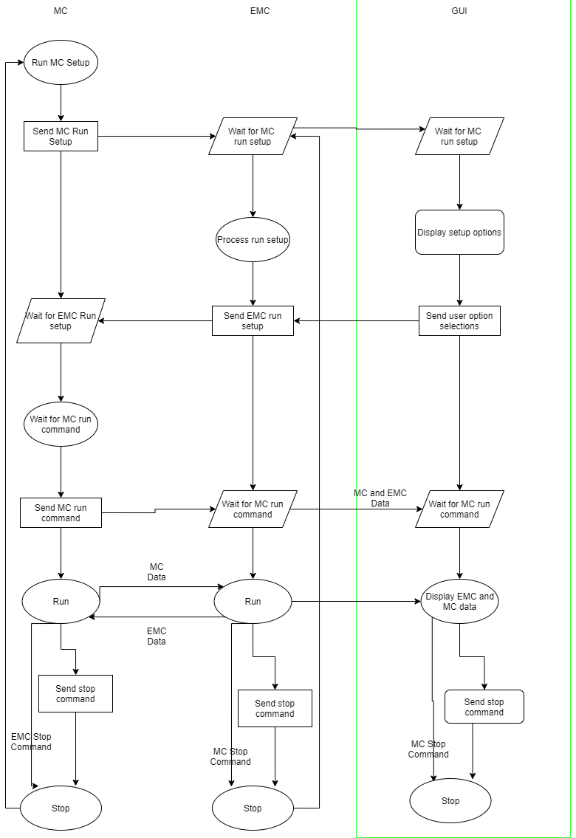
Design Diagram – Detailed Functions

Slide 10
Constraints
Professional / Technical Expertise:
EMC-GUI must connect to the EMC server to work.
I have not used the EMC before.
Someone familiar with the EMC server will need to assist with testing.
Feedback from people who use the server frequently is necessary.
Time:
Connection to EMC server is required for testing.
Testing will have to be done in-office at Wright-Patterson AFB in Dayton.
Time required to drive to and from Dayton will have to be considered.
Testing can only be done at times when the motion system is not being used for research.
Time spent on the project will have to be balanced with other classes and part time work.
Scope:
There is only one team member.
Project scope should be manageable by one person.
Project scope should still be large enough to create a useful product.

Slide 11
Current Project State
Discussed project timeline and end goals with Project Advisor Dr. Gallagher.
Discussed project requirements with NAMRU Senior Software Developer.
Reviewed Software Interface Design Description for the Disorientation Research Device (EMC and MC).
EMC-GUI can send and receive UDP packets.
Needs to be tested with a real server connection.
EMC settings UI has been created and the user can choose settings.
Selections not sent to server yet.

Slide 12
Expected Accomplishments – Fall 2021
Client should be able to send UDP messages containing structs.
Received data should sorted and displayed properly based on data type.
Order of operations should be established.
If time/progress allows – a test run.

Slide 13
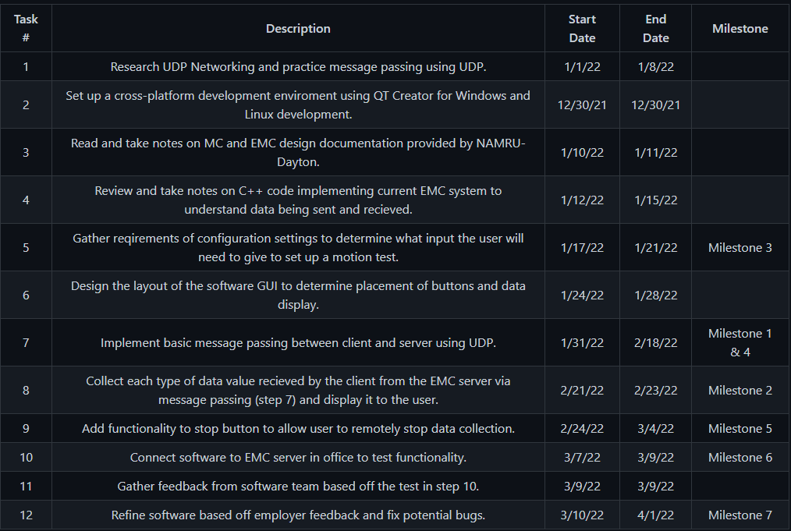
Timeline

Slide 14
Expected Demo
Client will need to be tested in-office for EMC connection.
Successful test run will need to be recorded for presentation.
Feedback from researchers to show improvement over the old system.

